Slide 1

A Brief Overview of

Slide 2
Before we get started
Sign up for GitHub Pro with a student developer pack:
Education.github.com/pack
-Free GitHub Pro
-Free domain name and hosting
-Free cloud services
-Learning resources, developer tools and services (next slide)
-Much more

Slide 3
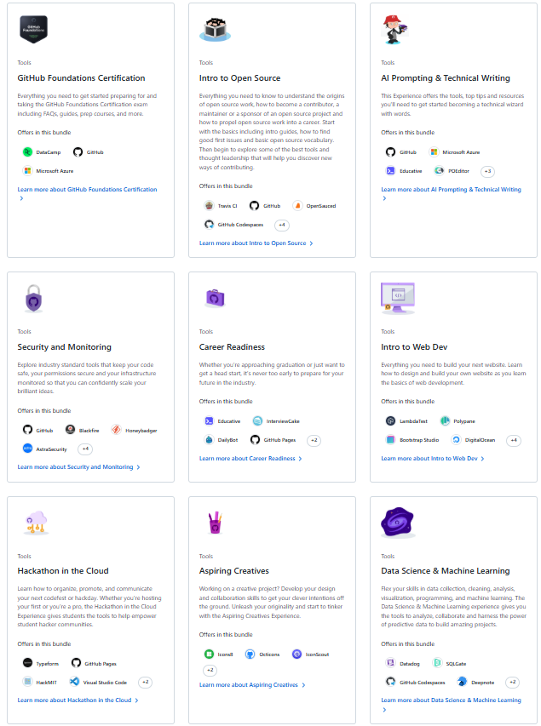

Slide 4
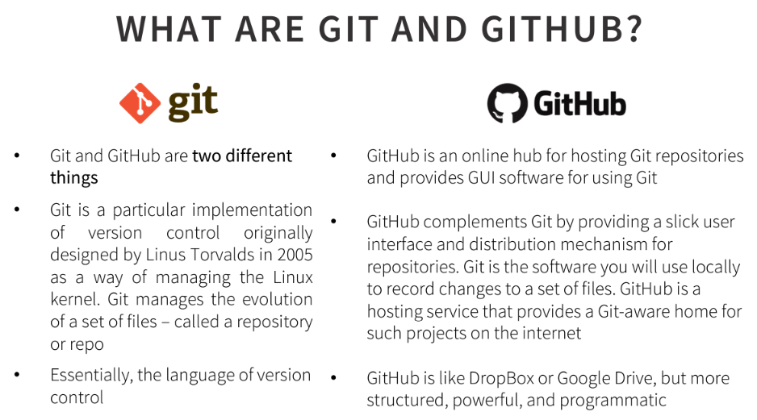

Slide 5
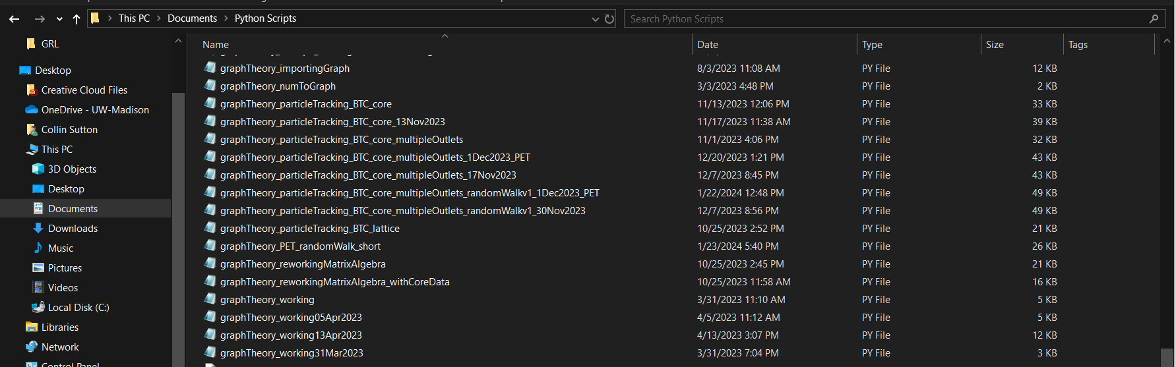
We’ve all been here before….

Slide 6
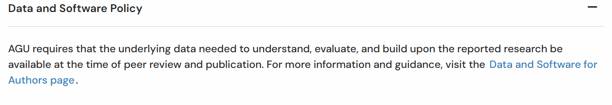
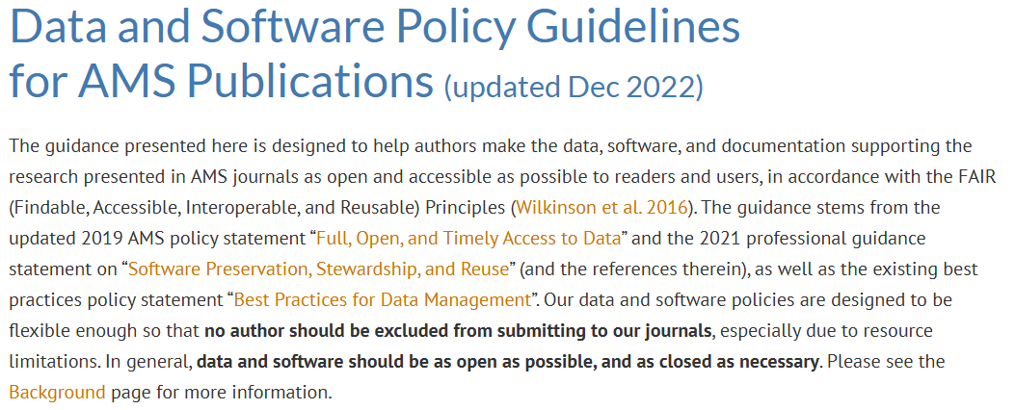

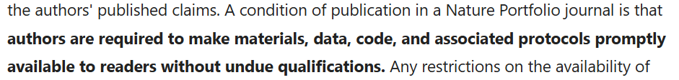
Open and collaborative science requirements

Slide 7
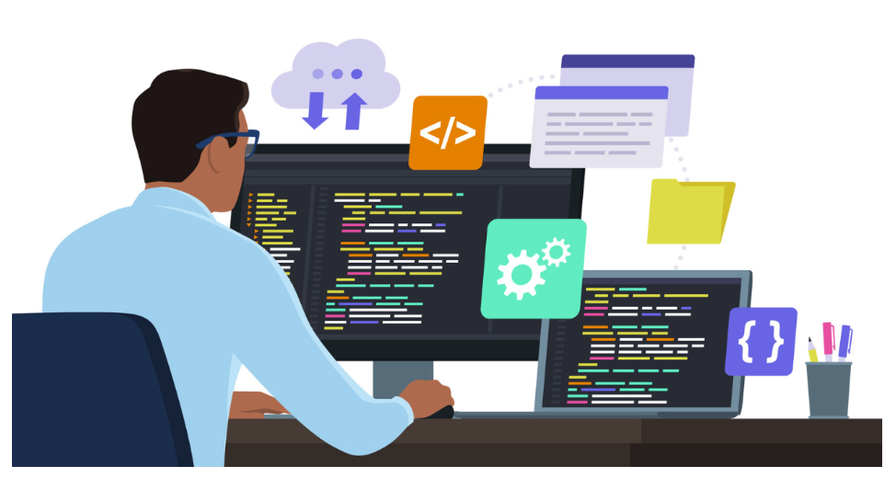
GitHub

Slide 8
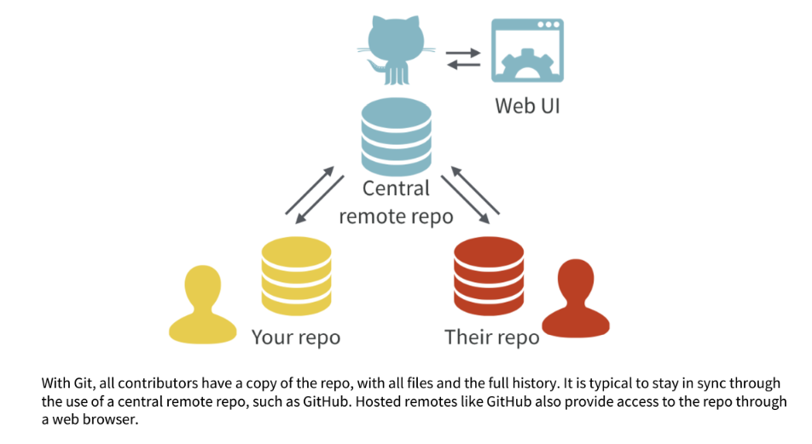

Slide 9
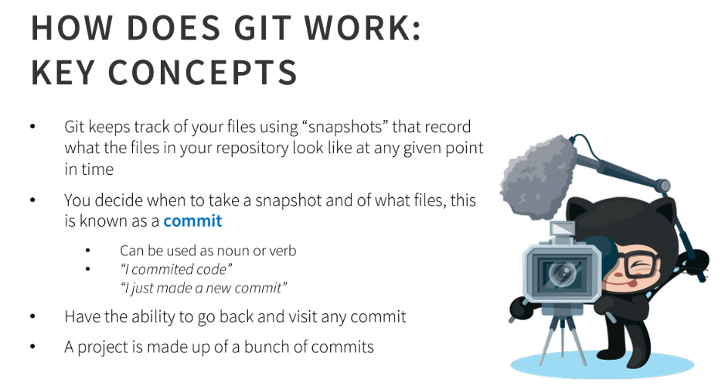

Slide 10
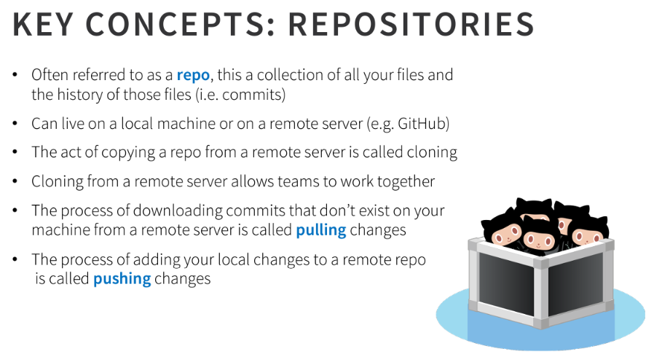

Slide 11
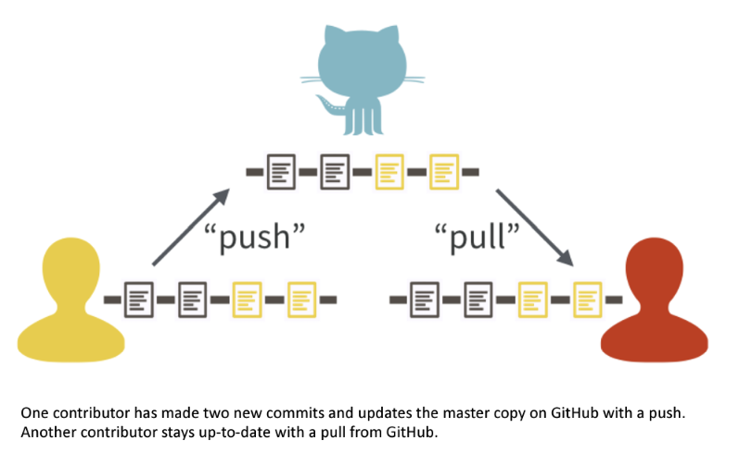

Slide 12
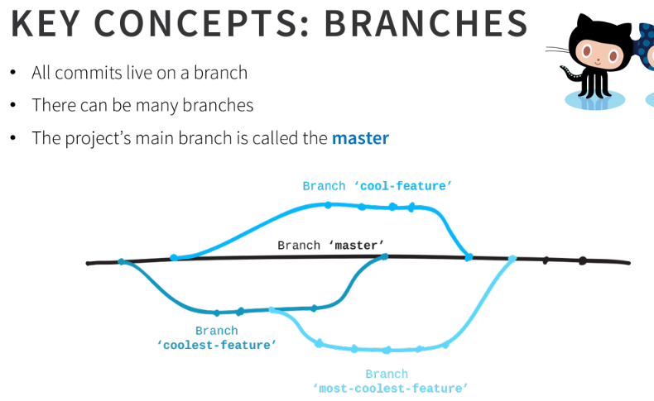

Slide 13
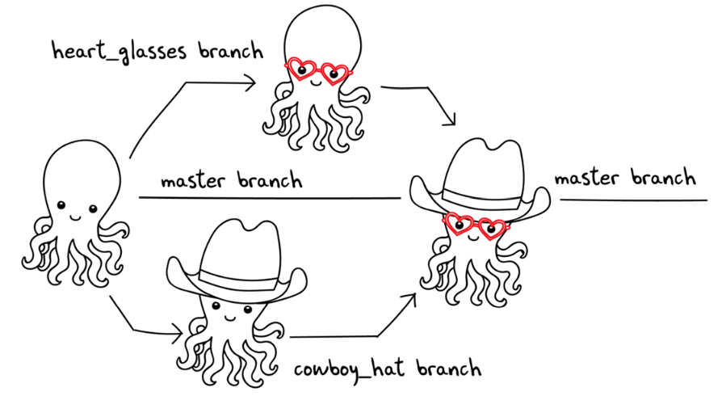

Slide 14
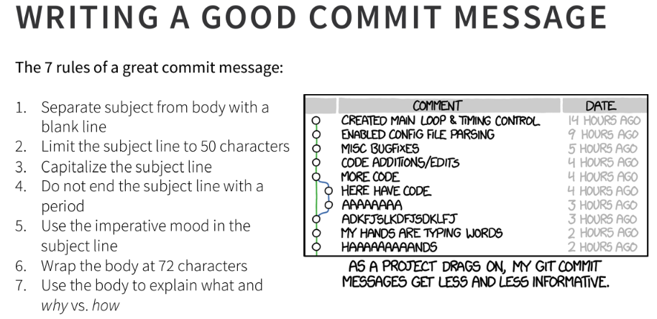

Slide 15
Essential GitHub Jargon I: Nouns
Repository: a GitHub-hosted remote directory (folder) that tracks changes in addition to hosting files.
Fork: an independent copy of a repository hosted on my account that allows editing locally but not on the original repository.
Clone: a locally downloaded repository. Edits in a clone can be uploaded back to the repository.
Branch: a version of a repository that diverges from the main version. Unlike a fork, it is still linked to its original repository.
Commit (n): A “snapshot” of a cloned repository that saves all changes since the last commit. The fundamental unit of version control

Slide 16
Essential GitHub Jargon II: Verbs
Fetch: refresh a cloned repository from the server.
Commit (v): The action of creating a commit. This must be done prior to any further Git action.
Push: send changes recorded by a commit back to the proper repository branch.
Pull Request: request your branch be reviewed for merging with the proper branch (usually the “master branch”).
Merge: The act of combining two branches into one while catching any contradictions between them.

Slide 17
Useful Resources
https://docs.github.com/en/get-started/start-your-journey/hello-world
https://tom.preston-werner.com/2009/05/19/the-git-parable.html

